Slide 1
Standard Form
WOLFF
ALGEBRA 1H

Slide 2
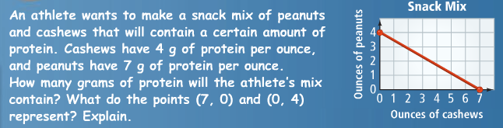

This is just an intro problem – don’t add to notes ☺

Slide 3
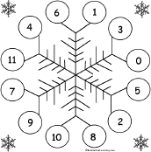
Review concept - Integers
Integers are non-fraction, non-decimal numbers
  Negatives and zero, inclusive
  Examples: -5, 0, and 31 are all integers

Slide 4
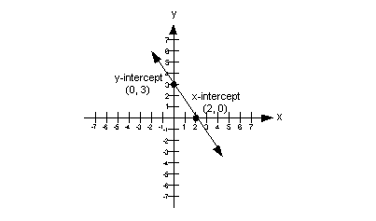
Review Concept - Intercepts
The x-intercept is the point where the graph crosses the x-axis (x, 0)
The y-intercept is the point where the graph crosses the y-axis (0, y)

Slide 5



New stuff – yaaaaaaaay!

Slide 6
Standard Form of a Linear Equation
Ax + By = C
A and B and C are all integers
A must be positive
A and B cannot both be zero
Any linear equation can be written in this format

Slide 7
Practice: Which of these equations are in Standard Form?
y = 7x + 8
-2x + 7y = 11
3x – 2y = 15
8x + 4y = -17
½ x + 3y = 9
x = 15
y = 11
.06x + .2y = .25

Slide 8
Converting to Integers
Decimals
  Multiply by a power of ten
  Use as many zeros as there are place values to the right of a decimal point
Example
  0.2x + 0.03y = 15
  (Multiply by 100)
  20x + 3y = 1500
Fractions
  Multiply by the least common denominator
Example
  y = -3/7x + 2
  (Multiply by 7)
  7y = -3x + 14
  (Convert to standard form by adding 3x to both sides)
  3x + 7y = 14

Slide 9
More Practice: Rewrite in Standard Form
y = 7x + 8 ½ x + 3y = 9
-2x + 7y = 11 .06x + .2y = .25

Slide 10
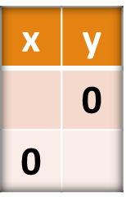
x and y intercepts
Find the x-intercept by substituting zero for y
Find the y-intercept by substituting zero for x
It is sometimes helpful to make a chart ☺

Slide 11
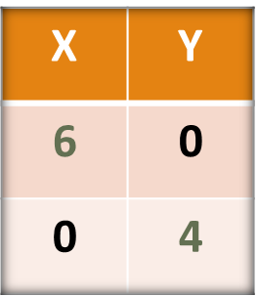
Let’s try one!
2x + 3y = 12
x-intercept:
2x + 3(0) = 12
2x = 12
2 2
x = 6
y-intercept:
2(0) + 3y = 12
3y = 12
3 3
y = 4

Slide 12
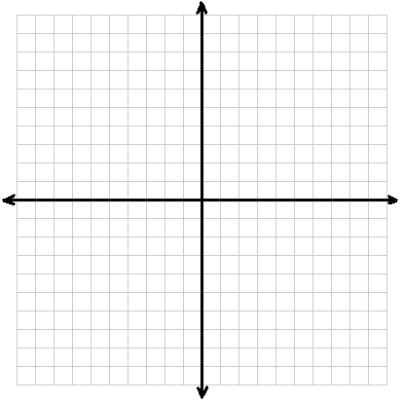
Graphing using Intercepts
Plot the intercepts.
Draw a line through them.

Slide 13
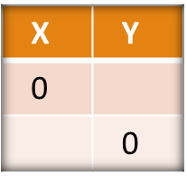
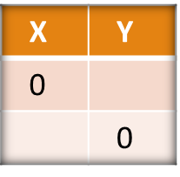
Your turn……
Find the x and y intercept for each of the equations.
7x + 3y = 42 5x – 3y = 18

Slide 14
Try these!
Find the intercepts and graph ☺
5x – 6y = 60 3x + 8y = 12

Slide 15
Special Lines

Slide 16

That’s all folks!
This part of the lesson is over. ☹

